Slide 1
Software Engineering Approach to Human-Computer-Interaction
Chapter 5 Visualized Design

Slide 2
Key Words
Alignment（对齐）
Associativity（关联性）
Consistency（一致性）
Reduction（减少）
Regularity（规律）
Proximity（接近性）
Selectivity（选择性）
Simplicity（简单）

Slide 3
Contents
5.1 Visual Interface Design Factors
5.2 Visual Interface Design Principles

Slide 4

5.1 Visual Interface Design Factors

Slide 5
Contrast & Visual Variables
Highlight differences
Visual variables---Bertin 1967
value
hue
texture
shape
position
orientation
size

Slide 6
Contrast & Visual Variables
Temperature
position
hue
shape

Slide 7
Characteristics of Visual Variables
Quantitative
is there a numerical reading obtainable from changes in this variable?
position
size
100
4 X
=
?
0
0
10

Slide 8
Characteristics of Visual Variables
Order
are changes in this variable perceived as ordered?
size
>
>
>
>
>
>
value
<
<
<
<
<
<
color
>
>
>
>
>
>
>
>
shape
>
>
>
>
>
>
>

Slide 9
Characteristics of Visual Variables
Length
across how many changes in this variable are distinctions perceptible?
Shape（ length - infinite variation）
orientation（ length - infinite variation）
~4 in 2D; ? in 3D

Slide 10
Attention
Recall the spotlight metaphor
Attention spotlight moves serially from one input channel to another
All stimuli within spotlighted channel are processed in parallel
Input channel = one or more visual variables
e.g., position, hue

Slide 11
Selectivity
Selective perception: can attention be focused on one value of the variable, excluding other variables and values?
Selective: position, size, orientation, hue, value, texture
Not selective: shape
Notes:
。

Slide 12
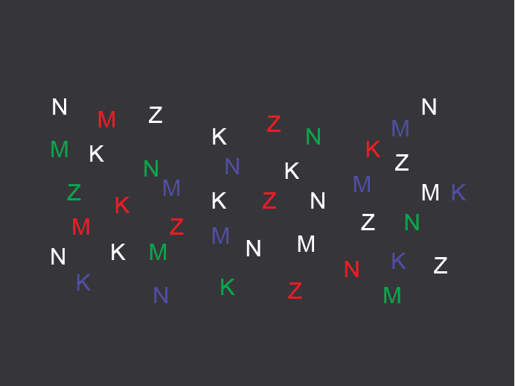

Slide 13
Associativity
Associative perception: can variable be ignored when looking at other variables?
Associative: position, hue, texture, shape, orientation
Not associative: size, value
Small size and low value interfere with ability to perceive hue, value, texture, and shape

Slide 14
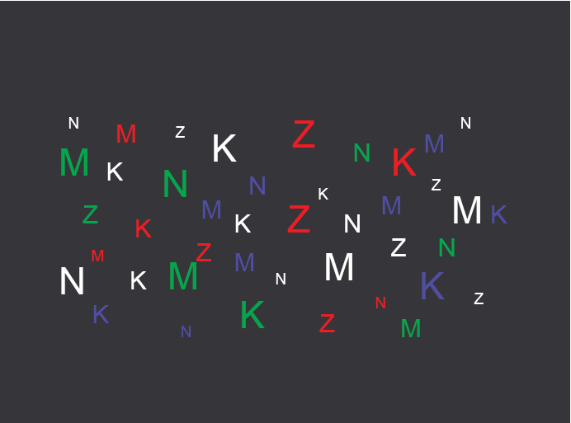

Slide 15
Stroop Effect
橙
红
绿
黑
蓝
粉

Slide 16
5.2 Visual Interface Design Principles

Slide 17
Guidelines for Good Graphic Design
Simplicity（简单）
Contrast（对比）
White space（留白）
Alignment （对齐）
Grouping and Structure（分组与结构）

Slide 18
Simplicity
“Perfection is achieved not when there is nothing more to add, but when there is nothing left to take away.”
“Simplicity does not mean the absence of any décor… It only means that the décor should belong intimately to the design proper, and that anything foreign to it should be taken away.”
“Keep it simple, stupid.”
“Less is more.”
“When in doubt, leave it out.”

Slide 19
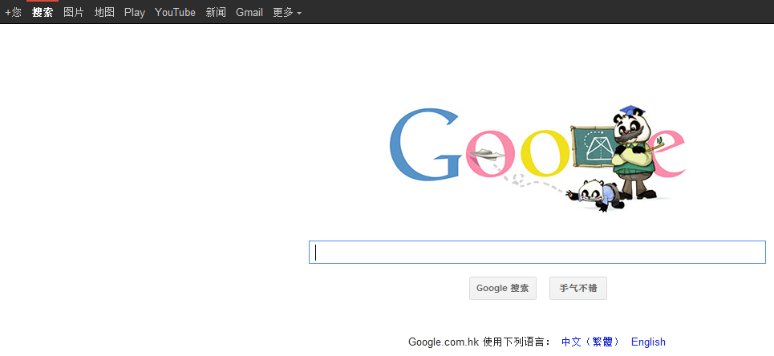
Techniques for Simplicity: Reduction
Remove inessential elements

Slide 20
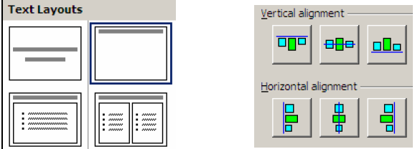
Techniques for Simplicity: Regularity

Slide 21
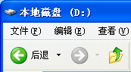
Techniques for Simplicity: Double-Duty
Combine elements for leverage
Find a way for one element to play multiple roles
Title Bar
Scrollbar Thumb

Slide 22

Techniques for Contrast
Choose appropriate visual variables
Use as much length as possible
Sharpen distinctions for easier perception
Multiplicative scaling, not additive
Redundant coding where needed
Cartoonish exaggeration where needed
Use the “squint test”

Slide 23
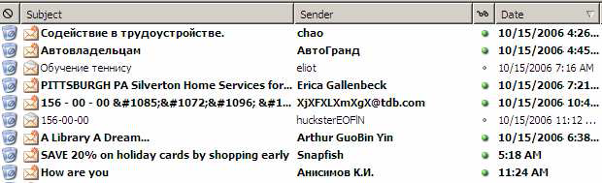
Choosing Visual Variables for a Display

Slide 24


Designing Information Displays
Title: HCI Bibliography:Human-Computer Interaction Resouces
Summary: The HCI Bibliography(HCIBIB) is a free-access bibliograhy on Humman-Computer Interaction, with over 70,000 records in a searchable databse…
Keywords: HCI
URL: www.hcibib.org/

Slide 25
Contrast in Publication Styles
Title
Heading
This is body text. It’s smaller than the heading, lighter in weight, and longer in line length. We’ve also changed its shape to a serif font, because serifs make small text easier to read. Redundant encoding produces an effective contrast that makes it easy to scan the headings and distinguish headings from body text.¹
Figure 1. This is a caption, which is smaller than body text, and set off by position, centering, and line length.
¹ This is footnote. It’s even smaller, and positioned at the bottom of the page.

Slide 26
Contrast Problems

Slide 27
White Space
Use white space for grouping, instead of lines
Use margins to draw eye around design
Integrate figure and ground
Object should be scaled proportionally to its background
Don’t crowd controls together
Crowding creates spatial tension and inhibits scanning

Slide 28
White Space - Space to Separate

Slide 29
White Space - Space to Structure
A
D
B
C
E
F

Slide 30
White Space - Space to Highlight

Slide 31
Crowded Dialog

Slide 32
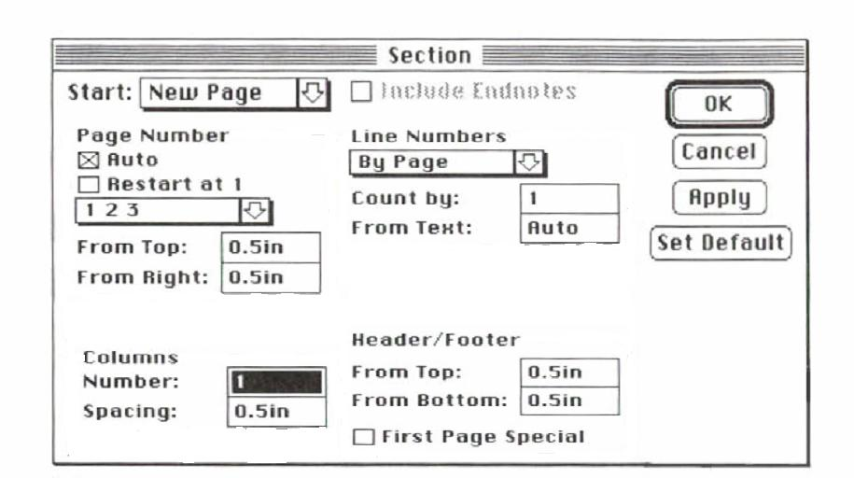
Crowded Dialog

Slide 33
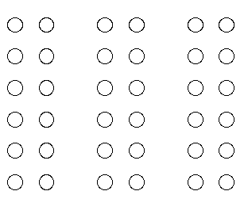

The Gestalt Principles of Grouping
Gestalt（格式塔） principles explain how eye creates a whole (gestalt) from parts
Proximity（接近性）
Similarity
（相似性）
Continuity
（连续性）
Closure（封闭性）
Figure/Ground
（主体/背景）
Symmetry
（对称性）

Slide 34
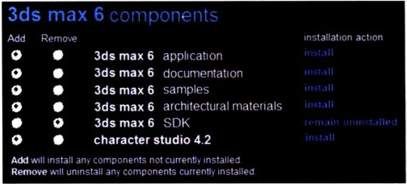
Proximity

Slide 35
Similarity

Slide 36
Continuity

Slide 37
Closure

Slide 38
Uses the Symmetry, Closure, and Continuity principles

Slide 39
Figure/Ground

Slide 40
Figure/Ground

Slide 41
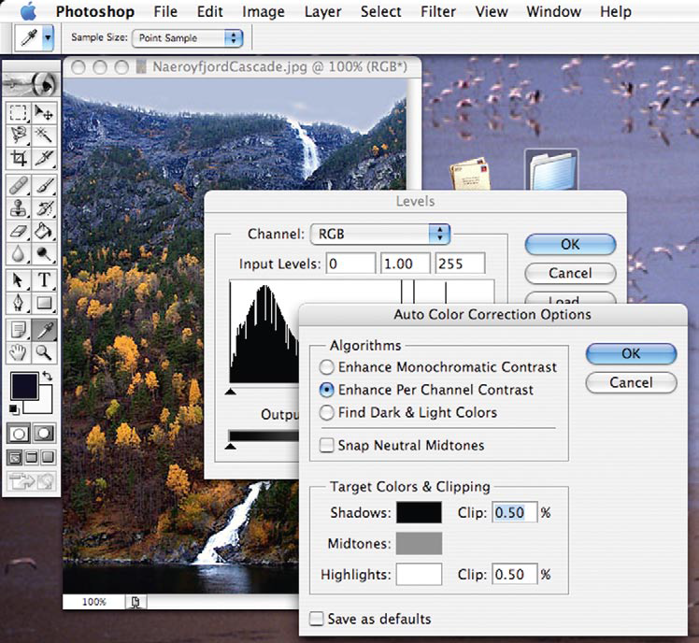
Gestalt Principles: Combined

Slide 42
Alignment - Text
you read from left to right ⇒ align left hand side
Willy Wonka and the Chocolate Factory
Winston Churchill - A Biography
Wizard of Oz
Xena - Warrior Princess
Willy Wonka and the Chocolate Factory
Winston Churchill - A Biography
Wizard of Oz
Xena - Warrior Princess

Slide 43
Alignment - Names
Usually scanning for surnames ⇒ make it easy!
✓
✗
Dix , Alan
Finlay, Janet
Abowd, Gregory
Beale, Russell
Alan Dix
Janet Finlay
Gregory Abowd
Russell Beale
✓
Alan Dix
Janet Finlay
Gregory Abowd
Russell Beale

Slide 44
Alignment - Numbers
which is the biggest?
align decimal points
532.56 179.3 256.317 15 73.948 1035 3.142 497.6256
627.865 1.005763 382.583 2502.56 432.935 2.0175 652.87 56.34

Slide 45
Multiple Columns
scanning across gaps hard: ---often hard to avoid with large data base fields
sherbert 75 toffee 120 chocolate 35 fruit gums 27 coconut dreams 85
sherbert 75 toffee 120 chocolate 35 fruit gums 27 coconut dreams 85

Slide 46
Multiple Columns
greying
even (with care!) ‘bad’ alignment
sherbert 75 toffee 120 chocolate 35 fruit gums 27 coconut dreams 85
sherbert 75 toffee 120 chocolate 35 fruit gums 27 coconut dreams 85

Slide 47
Grouping and Structure
logically together ⇒ physically together
Billing details:
Name
Address: …
Credit card no
Delivery details:
Name
Address: …
Delivery time
Order details:
item quantity cost/item cost
size 10 screws (boxes) 7 3.71 25.97
…… … … …

Slide 48
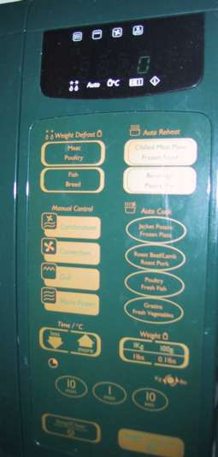
Physical Controls
grouping of items
defrost settings
type of food
time to cook

Slide 49
Physical Controls
grouping of items
order of items
1) type of heating
1
2) temperature
3) time to cook
2
4) start
3
4

Slide 50
Physical Controls
grouping of items
order of items
white space
gaps to aid grouping

Slide 51
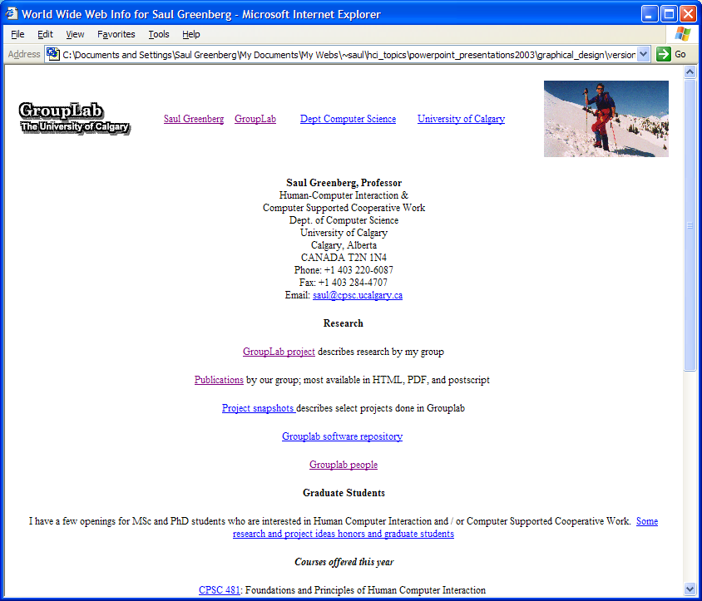
Original

Slide 52
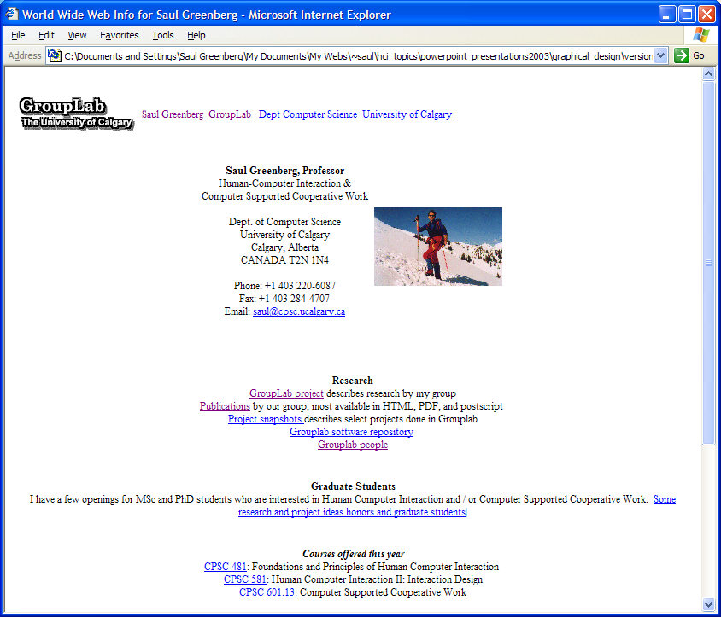
Proximity

Slide 53
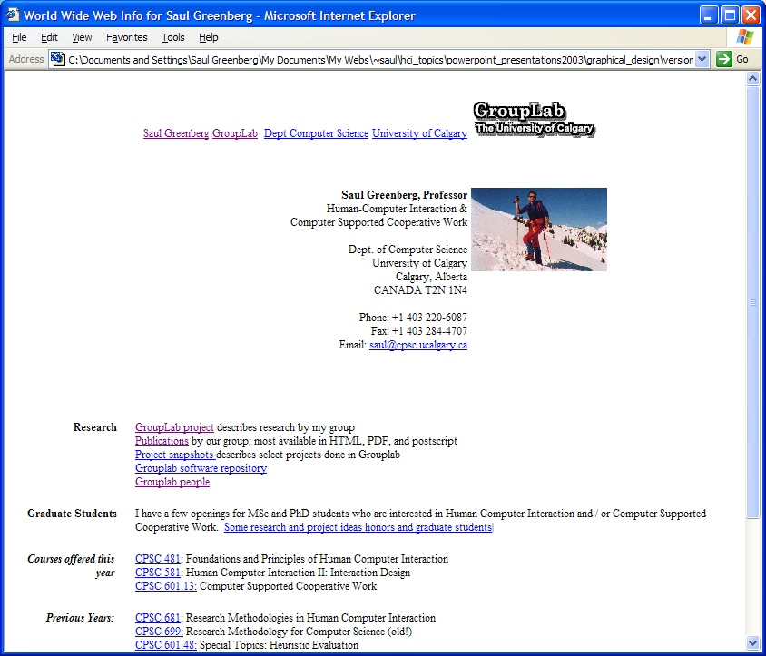
Alignment

Slide 54

Contrast

Slide 55

Consistency

